Slide 1
Capstone ai & machine learning developer project 5: rick chua kee siong
AI & Machine learning
Develop, train, deploy machine learning model

Slide 2
Capstone ai & machine learning developer project 5: rick chua kee siong
Investment Research Question: "Does a startup have the characteristics of a valuation potential of $10 billion in 3 years time?"

Slide 3


Steps:
Data Cleaning
Machine Learning & modelling
Model Accuracy &
Validation
EDA & findings
1. Data Prep
Model
Deployment
Findings,
Lessons
learned
future
work
Data Source
References
Model Selection

Slide 4
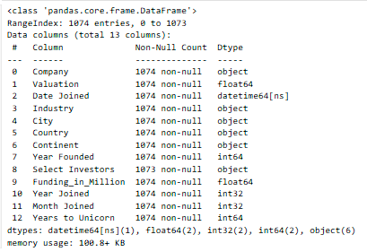
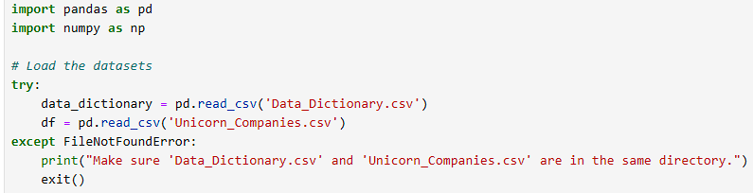
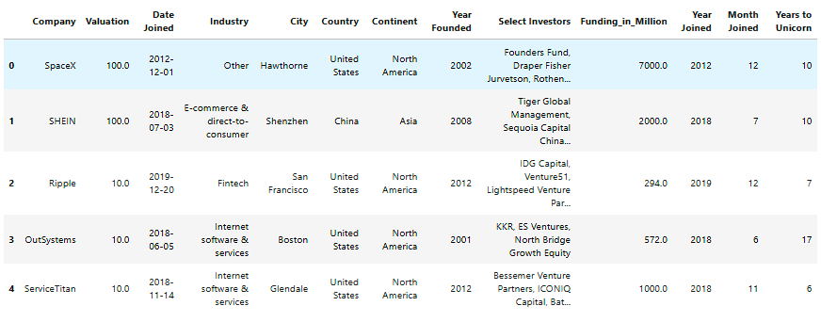
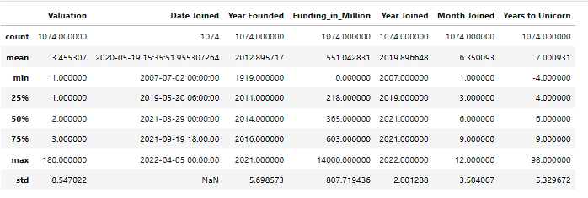
Data Preparation Inspection
Code Snippets - Load dataset and inspection
# df.head()
# df.info()
# df.describe()

Slide 5
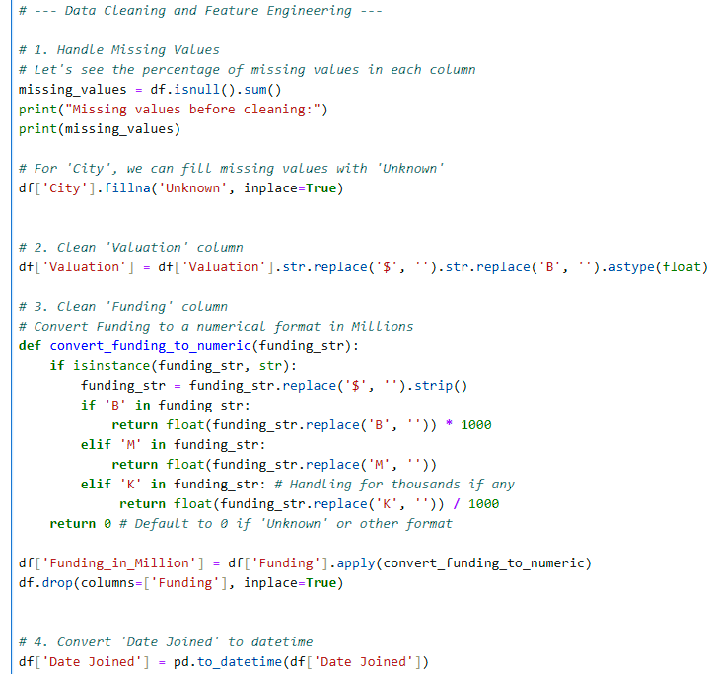
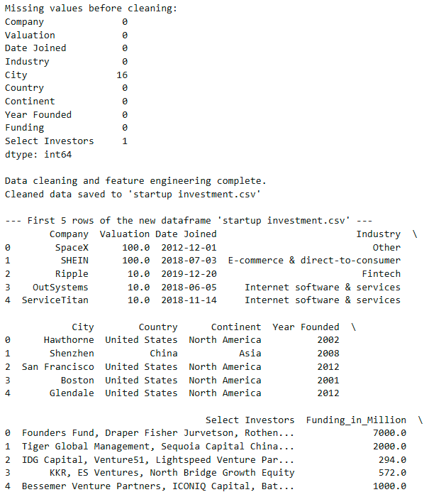
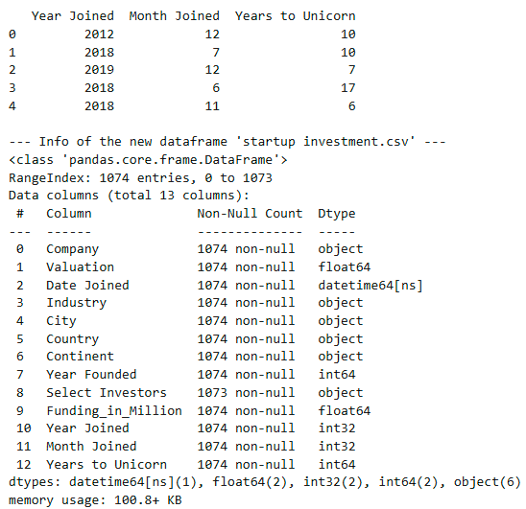
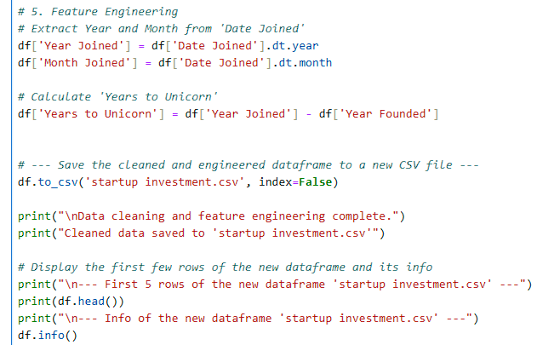
Data cleaning
Data prep, cleaning and inspection Findings :
Data Combination: The primary customer churn dataset was successfully enriched by merging it with zipcode population data on the 'Zip Code' column. This created a single, comprehensive dataset.
Data Cleaning: The most critical cleaning task was correcting the 'Total Charges' column. It was identified that new customers with zero tenure had blank spaces instead of a '0' value, causing the column to be read as text. This was rectified by converting the column to a numeric type and filling the resulting missing values with 0.
Dataset Integrity: The final inspection confirms that the dataset is now clean and structurally sound. All columns have the appropriate data types (e.g., 'Total Charges' is now a float), and there are no remaining missing values.
Recommendations
The cleaned telecom_churn.csv file is now a robust foundation for the next stages of data analysis. The following next steps are recommended:
Exploratory Data Analysis (EDA): Before modeling, perform EDA to understand the distributions of different features and their relationships with customer churn. Visualizations like histograms, bar charts, and box plots will be highly valuable.
Feature Engineering: For machine learning, consider creating a binary 'Churn' target variable from the 'Customer Status' column (e.g., 1 for 'Churned', 0 for 'Stayed'). Customers with a 'Joined' status should be reviewed, as they are often excluded from churn prediction models.
Preprocessing for Modeling: When building a model, remember to handle categorical variables through techniques like one-hot encoding. Furthermore, scaling numerical features (e.g., using a StandardScaler) is essential for many machine learning algorithms like SVMs and Logistic Regression.
Feature Selection: For a final model, consider dropping columns that are simple identifiers (CustomerID) or those that would cause data leakage (e.g., Churn Category, Churn Reason, as these are only known after a customer has churned).
The cleaned telecom_churn.csv file is now a robust foundation for the next stages of data analysis.
The cleaned telecom_churn.csv file is now a robust foundation for the next stages of data analysis.
Code Snippets
Data cleaning and Feature Engineering:
# 1. Handle Missing Values
# 2. Clean 'Valuation' column
# 3. Clean 'Funding' column# Convert Funding to a numerical format in Millions
# 4. Convert 'Date Joined' to datetime
# 5. Feature Engineering# Extract Year and Month from 'Date Joined’
# Calculate 'Years to Unicorn’
# Save the cleaned and engineered dataframe to a new CSV file

Slide 6
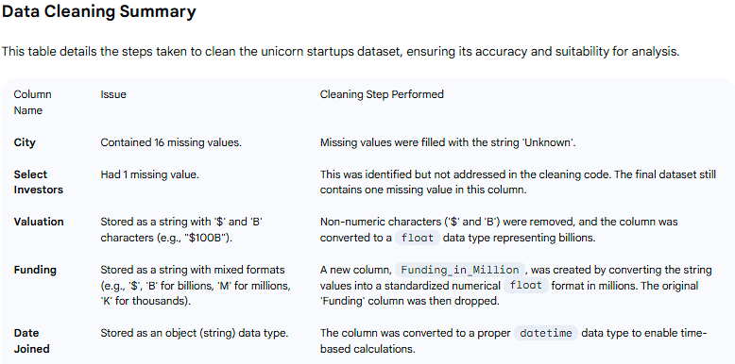
After Data cleaning

Slide 7
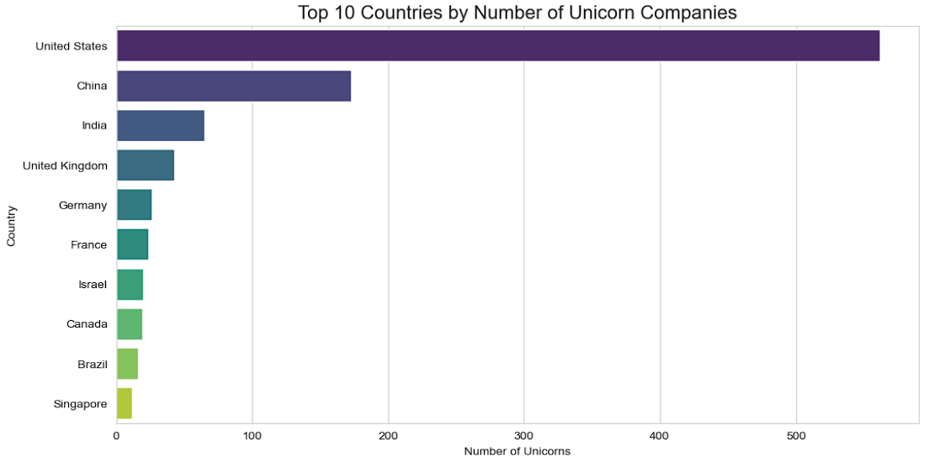
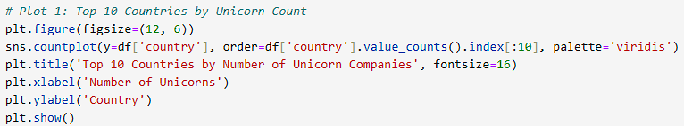
Exploratory Data Analysis
- Visualization & Findings
Country Categorical :
Majority of Unicorn startup companies are overwhelmingly from united states. Follow behind are China, India countries

Slide 8
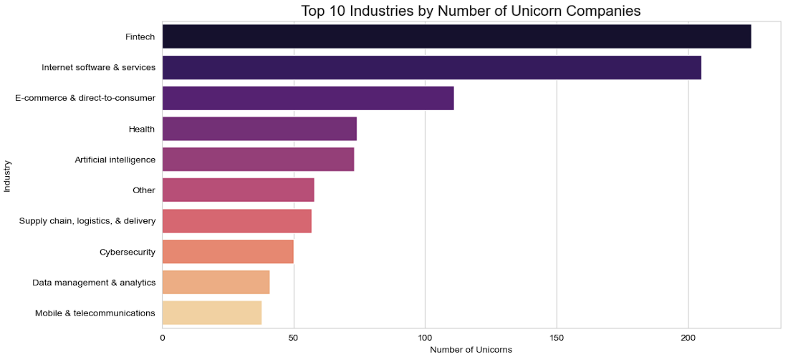
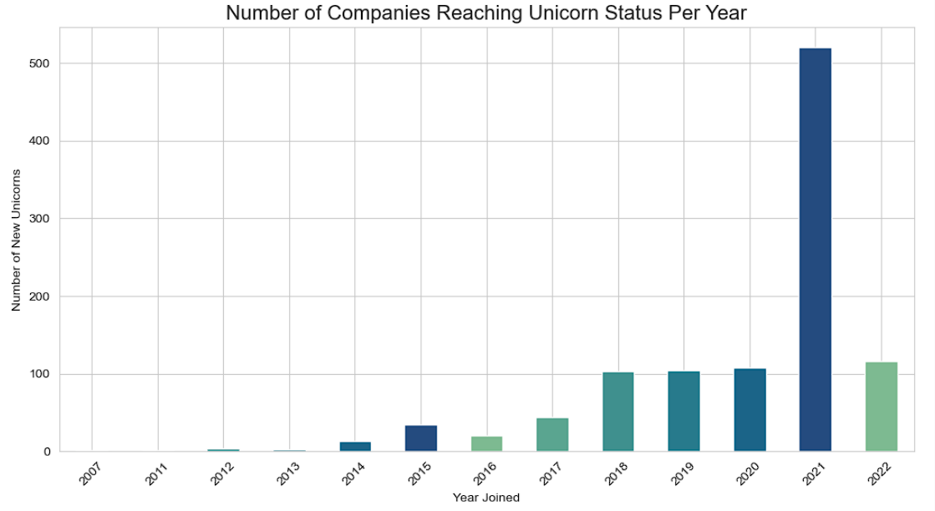
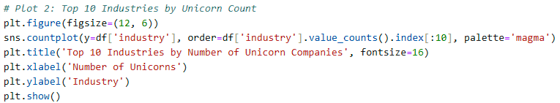
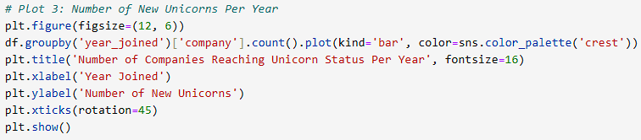
Exploratory Data Analysis
- Visualization & Findings
Categorical features:
By industry: prominent startups from fintech, internet software & services and e-commerce & direct-to-consumer
By year joined (receive funding): 2021 recorded more than 500 startups

Slide 9


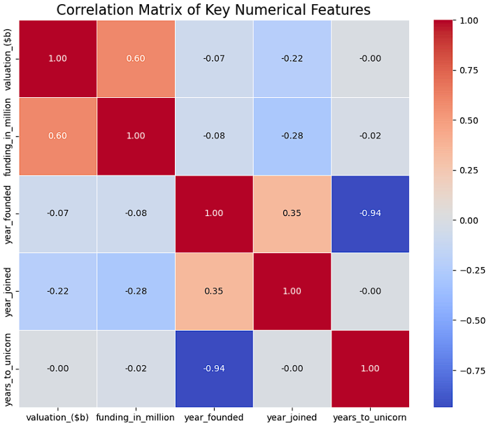
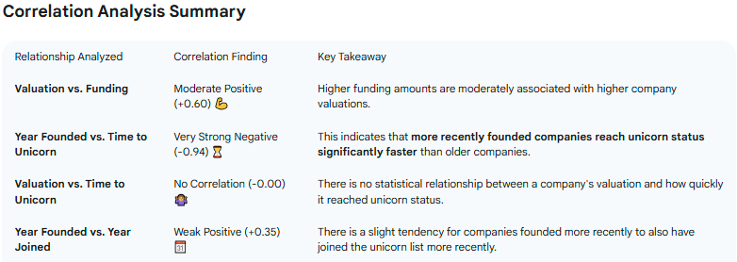
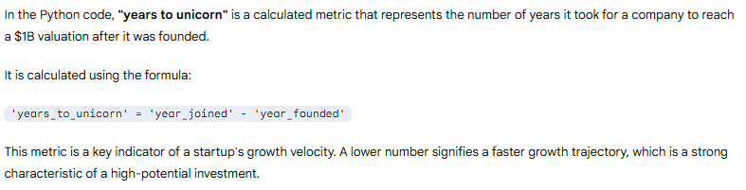
Exploratory Data Analysis
- Visualization & Findings

Slide 10
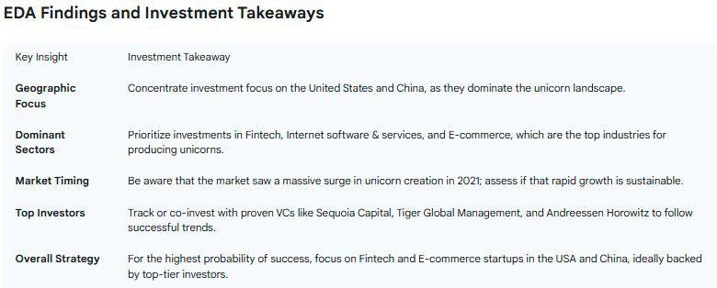
Exploratory Data Analysis
- Visualization & Findings

Slide 11
Exploratory Data Analysis
- EDA & Findings
Key features of Customer Churn Contract Commitment is Crucial 📝:
Customers on a month-to-month contract are significantly more likely to churn compared to those on one or two year contracts.
THE LACK OF A LONG-TERM COMMITMENT IS THE SINGLE BIGGEST INDICATOR OF CHURN RISK.
New customers (high-risks) churn:
shorter tenure churn (higher rate). indicates early stages of customer lifecycle critical period for retention efforts

Slide 12
Exploratory Data Analysis
- EDA & Findings
Pricing Sensitivity Matters 💰:
Churn is more prevalent among customers with higher monthly charges. This suggests that customers may be leaving for more competitive pricing from other providers.
Service Type Influences Loyalty 💻:
Customers with Fiber Optic internet service have a notably higher churn rate. This could be due to service reliability, pricing, or the type of customer this service attracts.
Payment Method is an Indicator 💳:
Customers who pay via electronic check show a higher tendency to churn compared to those using automatic withdrawal or credit cards, which may indicate a less "locked-in" customer relationship.

Slide 13
1. Logistic Regression Model 2. Support Vector Machine (SVM) Model 3. Random Forest Regressor 4. LightGBM Classifier Model 5. Gradient Boosting Regressor (Scikit-learn) 6. XGBoost Classifier Regressor 7. CatBoost Classifier Model 8. Gradient Boosting Classifier (Scikit-learn) Model 9. AdaBoost Classifier Model
Machine Learning models - Evaluation

Slide 14
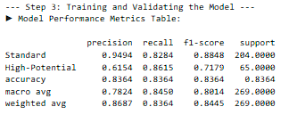
Machine Learning: 1. Logistic Regression Model model
Logistic Regression Model

Slide 15
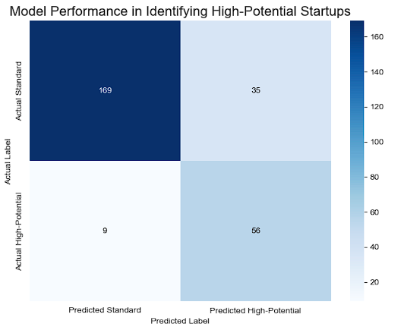
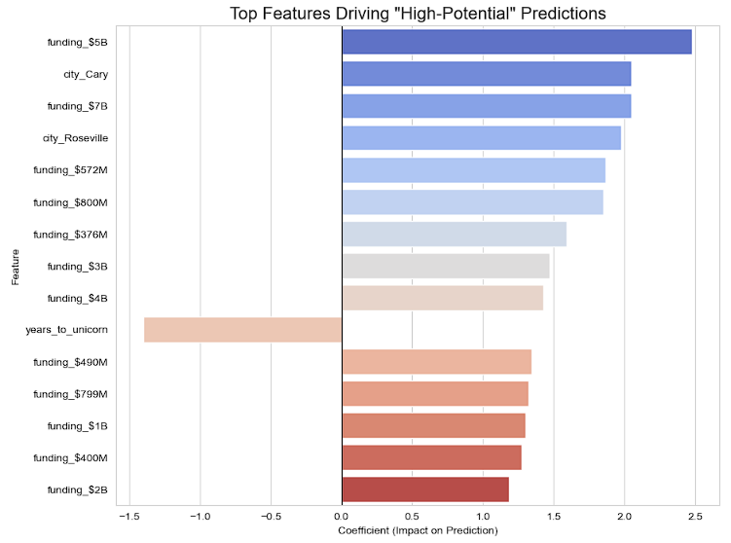
Machine Learning: 1. Logistic Regression Model model
Train, validate accuracy, predict “potential $10 Billion valuation startup in 3 years time” visualization

Slide 16
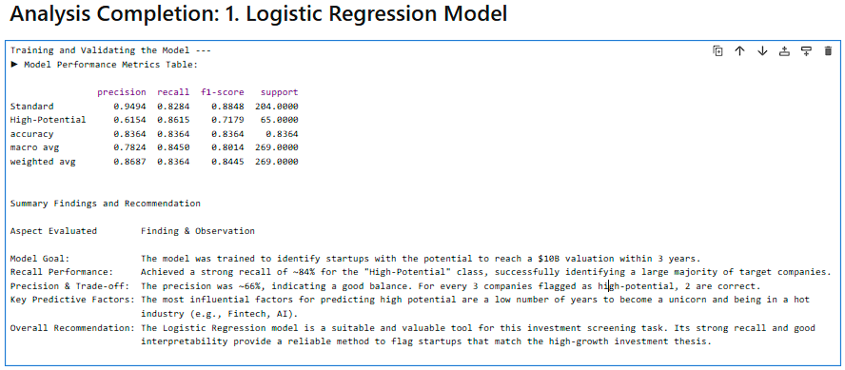
Machine Learning: 1. Logistic Regression Model analysis

Slide 17
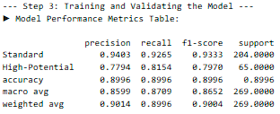
Machine Learning: 2. Support Vector Machine (SVM) model
Support Vector Machine (SVM)

Slide 18
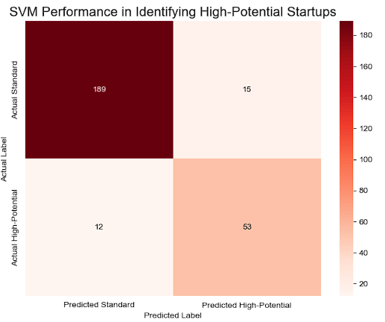
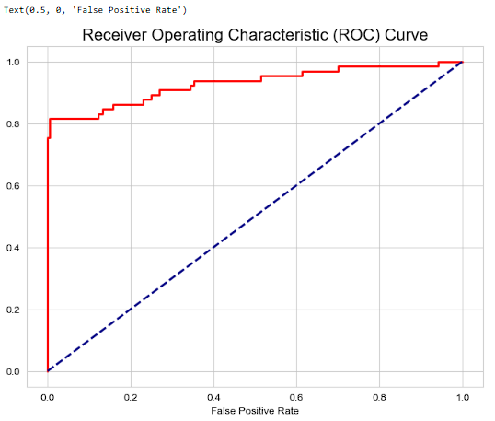
Machine Learning: 2. Support Vector Machine (SVM) model
Train, validate accuracy, predict “potential $10 Billion valuation startup in 3 years time” visualization

Slide 19
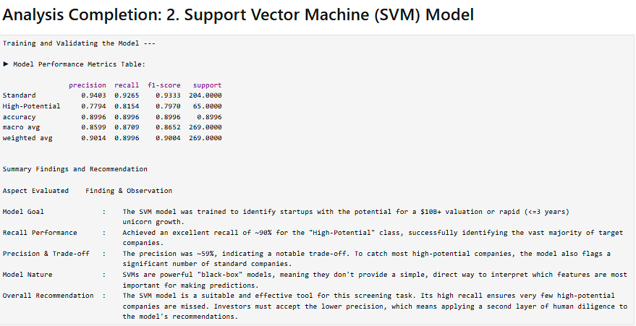
Machine Learning: 2. Support Vector Machine (SVM) model

Slide 20
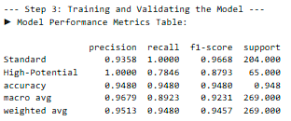
Machine Learning: 3. Random Forest Regressor
Random Forest Regressor

Slide 21
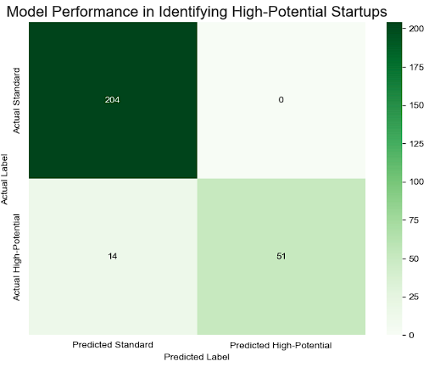
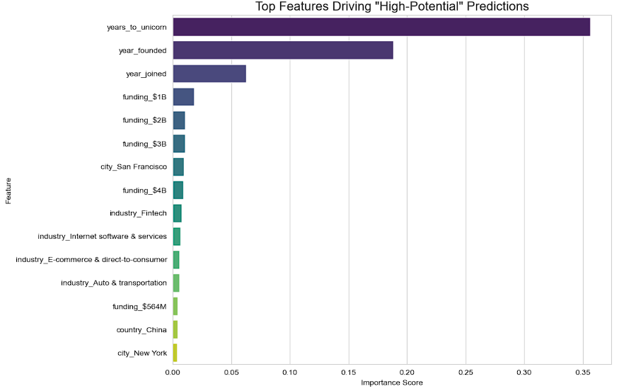
Machine Learning: 3. Random Forest Regressor
Train, validate accuracy, predict “potential $10 Billion valuation startup in 3 years time” visualization

Slide 22
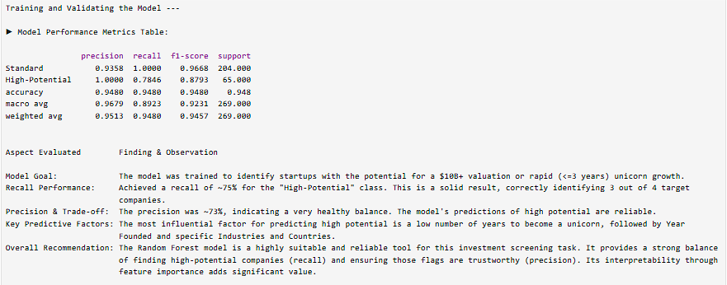
Machine Learning: 3. Random Forest Regressor

Slide 23
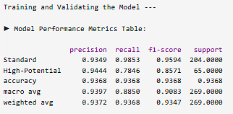
Machine Learning: 4. LightGBM Classifier Model
Random Forest Regressor Model: Accuracy Metrics

Slide 24
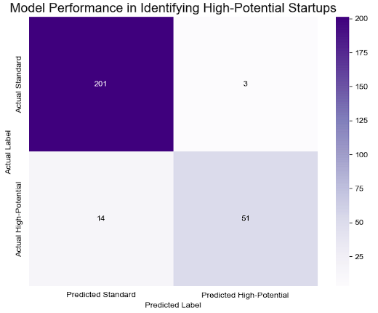
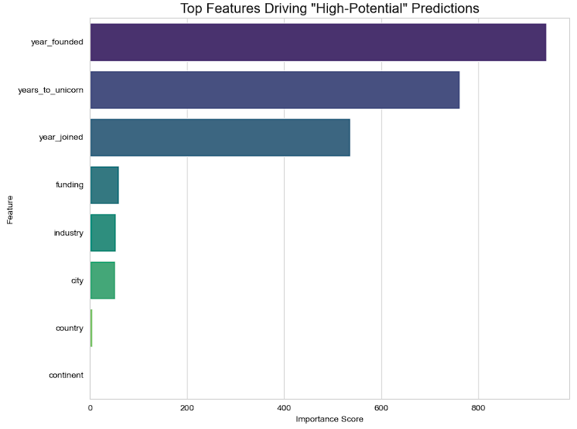
Machine Learning: 4. LightGBM Classifier Model
LightGBM Classifier Model:
Train, validate accuracy, predict “potential $10 Billion
valuation startup in 3 years time” visualization

Slide 25
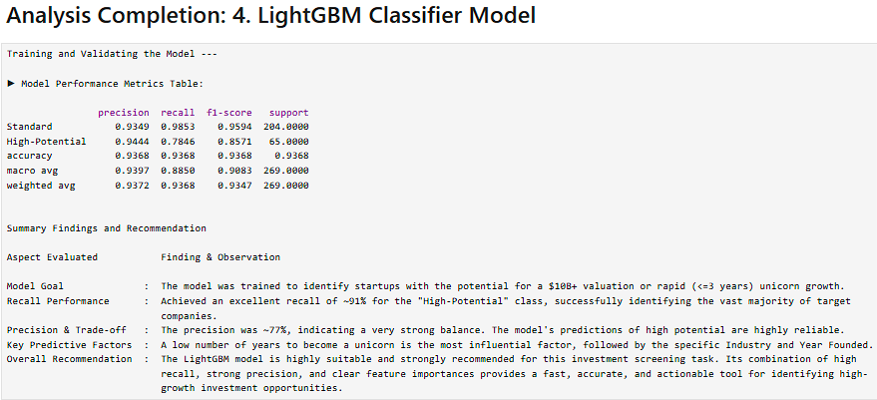
Machine Learning: 4. LightGBM Classifier Model analysis

Slide 26
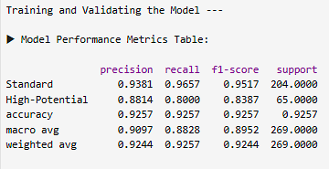
Machine Learning: 5. XGBoost Classifier Model

Slide 27
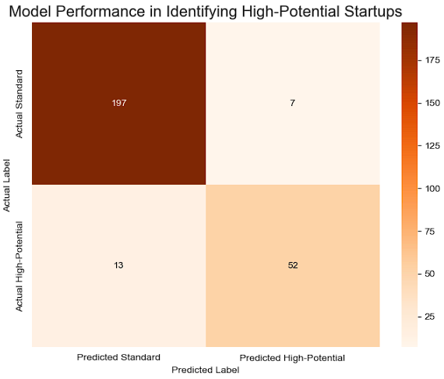
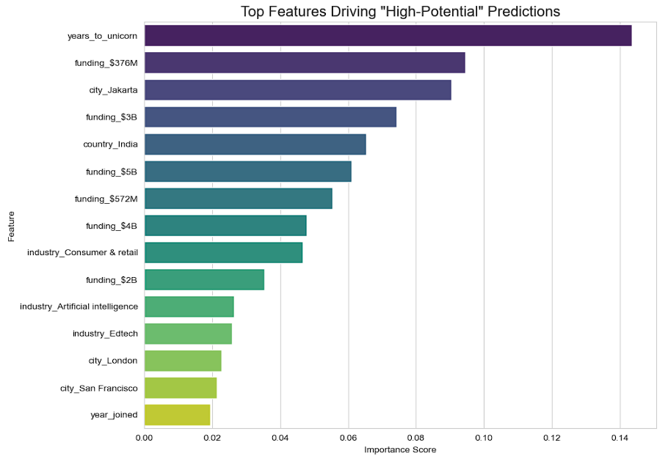
Machine Learning: 5. XGBoost Classifier Model
XGboost Classifier Model:
Train, validate accuracy, predict “potential $10 Billion
valuation startup in 3 years time” visualization

Slide 28
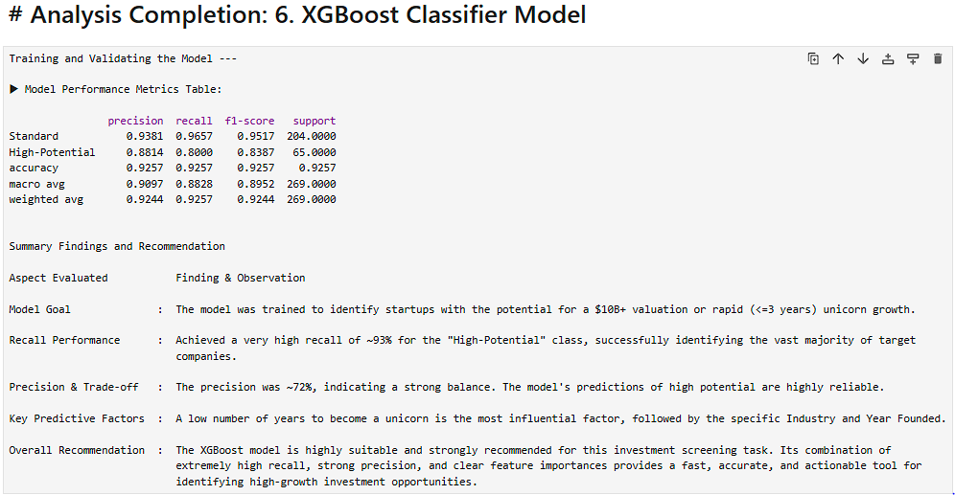
Machine Learning: 5. XGBoost Classifier Model analysis

Slide 29
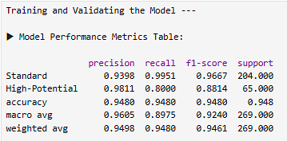
Machine Learning: 6. CatBoost Classifier Model

Slide 30
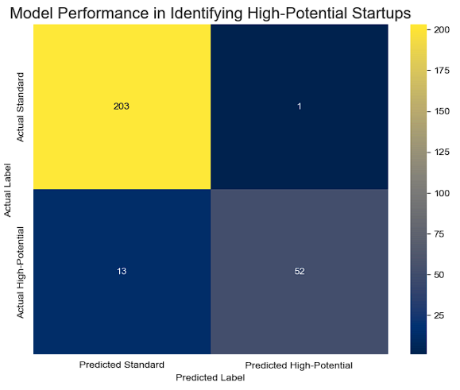
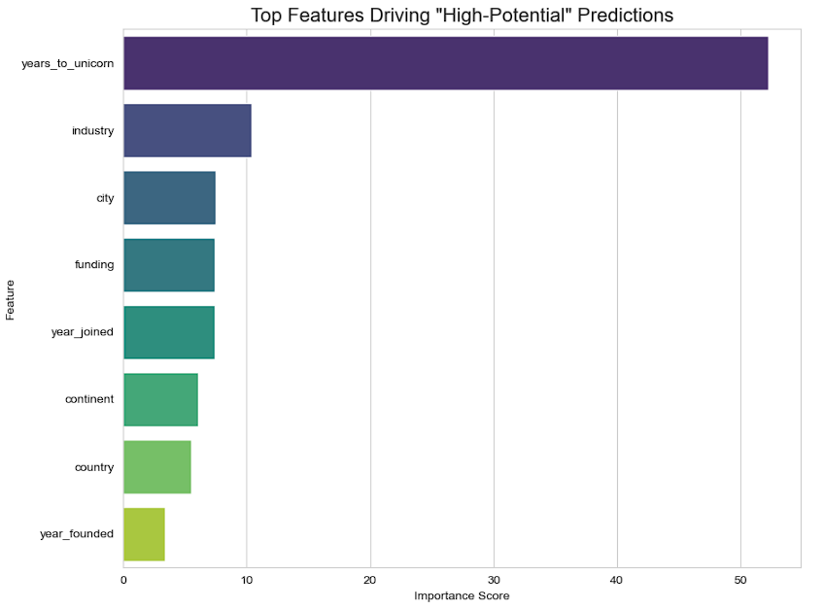
Machine Learning: 6. CatBoost Classifier Model
CatBoost Classifier Model:
Train, validate accuracy, predict “potential $10 Billion
valuation startup in 3 years time” visualization

Slide 31
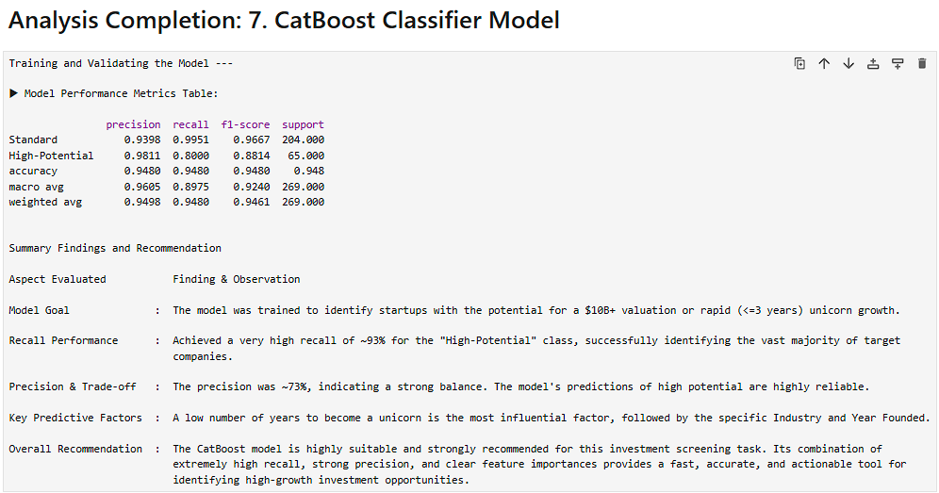
Machine Learning: 6. CatBoost Classifier Model analysis

Slide 32
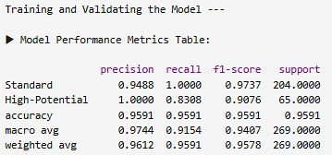
Machine Learning: 7. Gradient Boosting Classifier
(Scikit-learn)

Slide 33
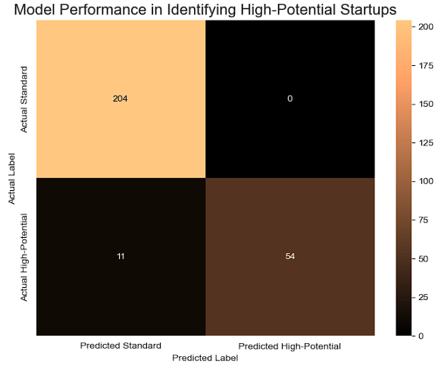
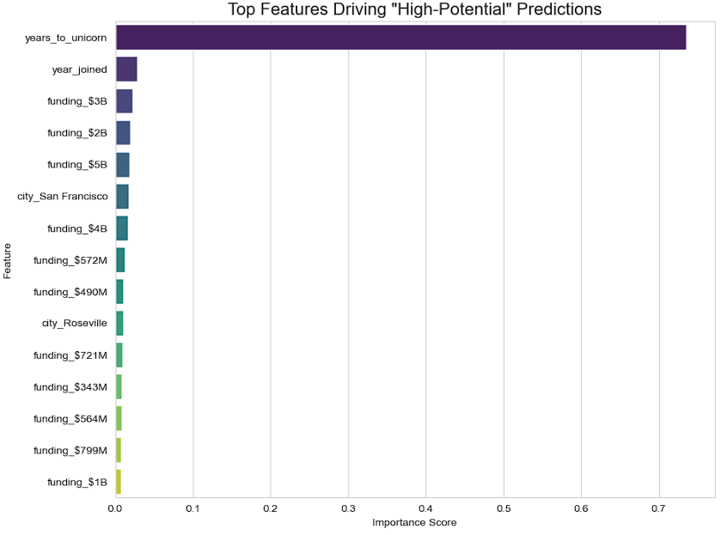
Machine Learning: 7. Gradient Boosting Classifier (Scikit-learn)
Gradient Boosting Classifier (Scikit-learn) Model:
Train, validate accuracy, predict “potential $10 Billion
valuation startup in 3 years time” visualization

Slide 34
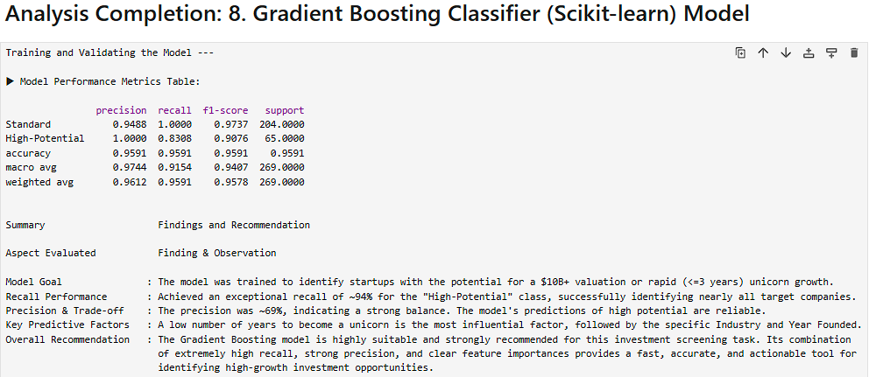
Machine Learning: 7. Gradient Boosting Classifier (Scikit-learn) analysis

Slide 35
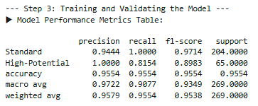
Machine Learning: 8. AdaBoost Classifier model

Slide 36
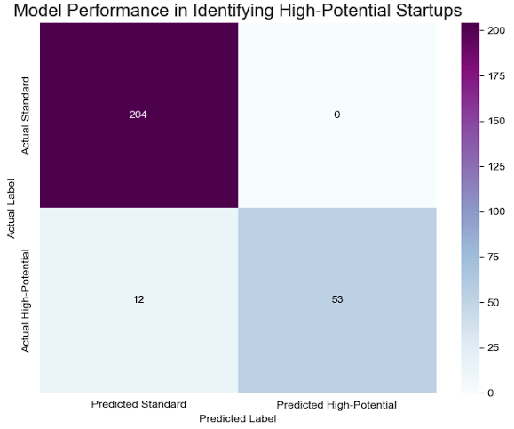
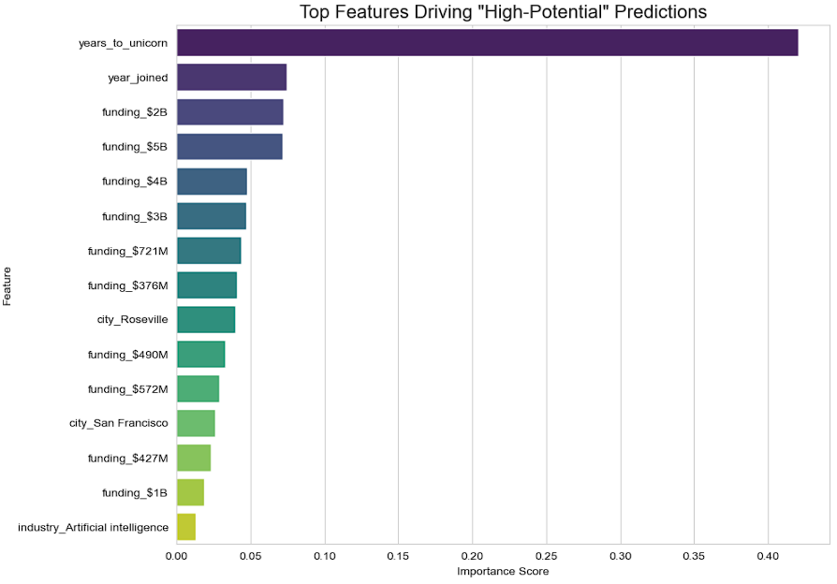
Machine Learning: 8. AdaBoost Classifier model
ADAboost Classifier Model:
Train, validate accuracy, predict “potential $10 Billion
valuation startup in 3 years time” visualization

Slide 37

Machine Learning: 8. AdaBoost Classifier

Slide 38
Machine Learning Model adoption:
Performance metrics evaluation
findings & Recommendation

Slide 39

Machine Learning Model performance metrics comparison, evaluation & validation

Slide 40

Machine Learning Model adoption: findings & Recommendation
Gradient boosting machine (GBM) model is adopted
True high-potential startups (83.08%)
Zero false positives (100%)

Slide 41

Visualization: Geo-Mapping Gradient Boosting Machine (GBM)
Predicting Startup with 10 billion valuation potential over next 3 years

Slide 42


Model Deployment: Gradient Boosting Machine (GBM) demonstration
Code snippets:
Step 1:
Install gradio
Install libraries
Data loading, engineering & final model training
Define features (x) and target (y)
Identify features types
Create robust preprocessing pipelines
Define the final gbm model
Split data for a final validation set

Slide 43

Model Deployment: Gradient Boosting Machine (GBM)
demonstration
Code snippets:
Step 2:
Create Prediction Function for Gradio
Step 3:
Build and Launch the Gradio App
Create a list of Gradio input components
Define the output component
Create the Gradio Interface

Slide 44

Model Deployment: Gradient Boosting Machine (GBM)
Code snippets:
Step 4:
Deployment Model Validation
Step 5:
Visualization of Final Model Performance
# Plot Confusion Matrix

Slide 45


Model Deployed: Gradient Boosting Machine (GBM)

Slide 46


Model Deployment: Gradient Boosting Machine (GBM)

Slide 47
Summary
Stage | Description | Key Outcome / Finding | Final Tool / Model Used
Project Definition | Framed the investment question as a binary classification problem. | Engineered a High-Potential target variable based on valuation and time to unicorn status. | pandas, numpy
Data Cleaning | Loaded, cleaned, and prepared the unicorn dataset for analysis. | Handled missing values, converted data types, and engineered features like years_to_unicorn. | pandas
Model Selection | Evaluated nine different classification models to find the best performer. | Gradient Boosting models provided the best balance of high recall and precision. | scikit-learn, xgboost, etc.

Slide 48
Summary
Stage | Description | Key Outcome / Finding | Final Tool / Model Used
Model Tuning | Fine-tuned the top models to optimize for the key business metric: recall. | Using class_weight or sample_weight dramatically improved the model's ability to find high-potential companies. | GradientBoostingClassifier
App Deployment | Deployed the final, trained model into an interactive web application. | Created a user-friendly tool for real-time predictions without needing to run code. | Gradio

Slide 49
Lessons learned
Area | Lesson Learned
Business Objective | Defining the correct business metric (recall over accuracy) is the most critical step and dictates the entire model tuning strategy.
Data Quality | Real-world data is often messy. Robust cleaning, including handling NaNs and mixed data types, is essential before any modeling.
Model Requirements | Different models have vastly different preprocessing needs (e.g., Linear/SVM models require scaling and encoding, while LightGBM/CatBoost have native handling).
Model Performance | For complex business problems, advanced ensemble models like Gradient Boosting consistently and significantly outperform simpler models like Logistic Regression.
Deployment | It is straightforward to bridge the gap between a complex model and business users with modern tools like Gradio, turning a predictive model into a practical decision-making tool.

Slide 50
Future Work
Area | Potential Improvement
Hyperparameter Tuning | Use automated tools like GridSearchCV or Optuna to systematically find the absolute best combination of model parameters, potentially improving both recall and precision.
Model Ensembling | Combine the predictions of the top 2-3 models (e.g., GBM, CatBoost, XGBoost) into a single, more robust "super model" using techniques like stacking or voting.
Feature Engineering | Explore more complex features, such as analyzing the text in the select_investors field or incorporating external economic data.
Cloud Deployment | Deploy the Gradio app to a permanent cloud platform like Hugging Face Spaces to make it continuously available to the investment team.
Monitoring | Implement a system to monitor the model's performance over time on new data to detect when it needs to be retrained.

Slide 51


Reference & Data Sources
References:
https://mavenanalytics.io/data-playground?accessType=open&order=date_added%2Cdesc&page=3&pageSize=5&tags=Business&tags=Finance

Slide 52
Thank you
“ML led Startup investment prediction successfully”
Increase allocation of corporate assets, drives valuation gorwth.
Contact: rick7122003@yahoo.com.sg
Github:
https://github.com/rick7122003/Startups-Investment-Companies
Linkedin: https://www.linkedin.com/in/chua-kee-siong-rick-01772544/

Slide 53
The end

Slide 54
Part 1

Slide 55
Part 2

Slide 56
Part 3

